Slide 1
Elementary Graph Algorithms
SUBMITTED BY :- ABHISHEK LUTHRA
ROLL NO. :- 181210003
CSE 2ND Year

Slide 2
GRAPH :-
A Graph is a non-linear data structure consisting of nodes and edges. The nodes are sometimes also referred to as vertices and the edges are lines or arcs that connect any two nodes in the graph.
More formally a Graph can be defined as, A Graph consists of a finite set of vertices(or nodes) and set of Edges which connect a pair of nodes.

Slide 3
REPRESENTATION OF GRAPH :-
We have two standard ways to represent a graph G = (V,E) as a collection of adjacency lists or as an adjacency matrix.
Either way applies to both directed and undirected graphs.
We use adjacency matrix representation for dense graphs and adjacency list representation for sparse graph.

Slide 4
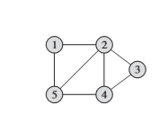
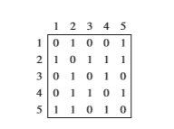
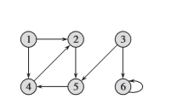
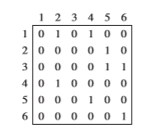
1. Adjacency matrix representation
EXAMPLE - 1 :-
EXAMPLE – 2 :-

Slide 5
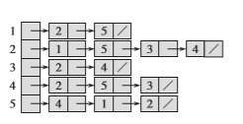
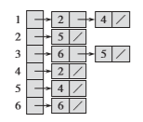
2. Adjacency lists representation
EXAMPLE - 1 :-
EXAMPLE – 2 :-

Slide 6
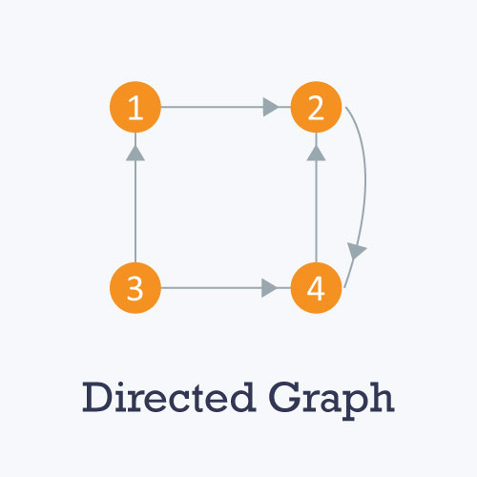
Directed graph :-
A directed graph is a graph in which all the edges are uni-directional i.e. the edges point in a single direction.

Slide 7
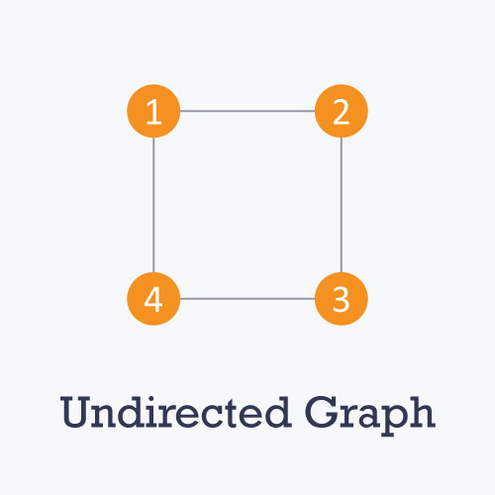
Undirected graph :-
An undirected graph is a graph in which all the edges are bidirectional i.e. the edges do not point in any specific direction.

Slide 8
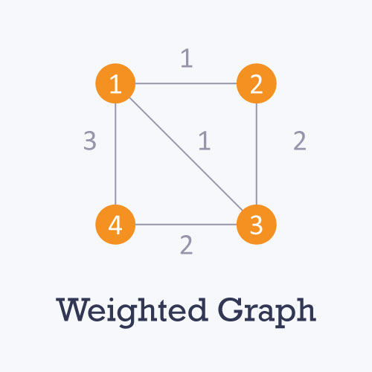
Weighted graph :-
GRAPH – weighted graph
In a weighted graph, each edge is assigned a weight or cost. Example :-

